Slide 1

Preventing Stormwater Pollution What We Can Do
General Public Information on
Recognizing and Reporting Illicit Discharges
Borough of Exeter
Prepared in Cooperation with the North Central Texas
Regional Stormwater Management Program

Slide 2
Training Goals
Understand the terms “stormwater” and “illicit discharge”
Understand why these terms are important and why you should care
Understand what you can do to help prevent stormwater pollution
Understand how to recognize and report illicit discharges (pollution)

Slide 3
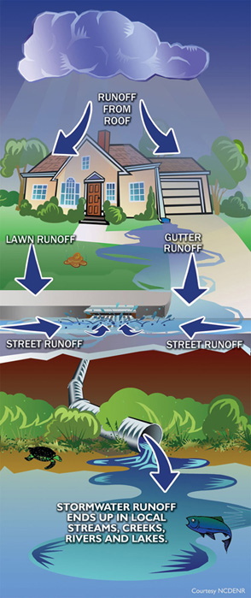
What is Stormwater?
When it rains, water that does not soak into the ground becomes runoff
This runoff can enter a storm sewer system which ends up in local streams, creeks, rivers, and lakes

Slide 4

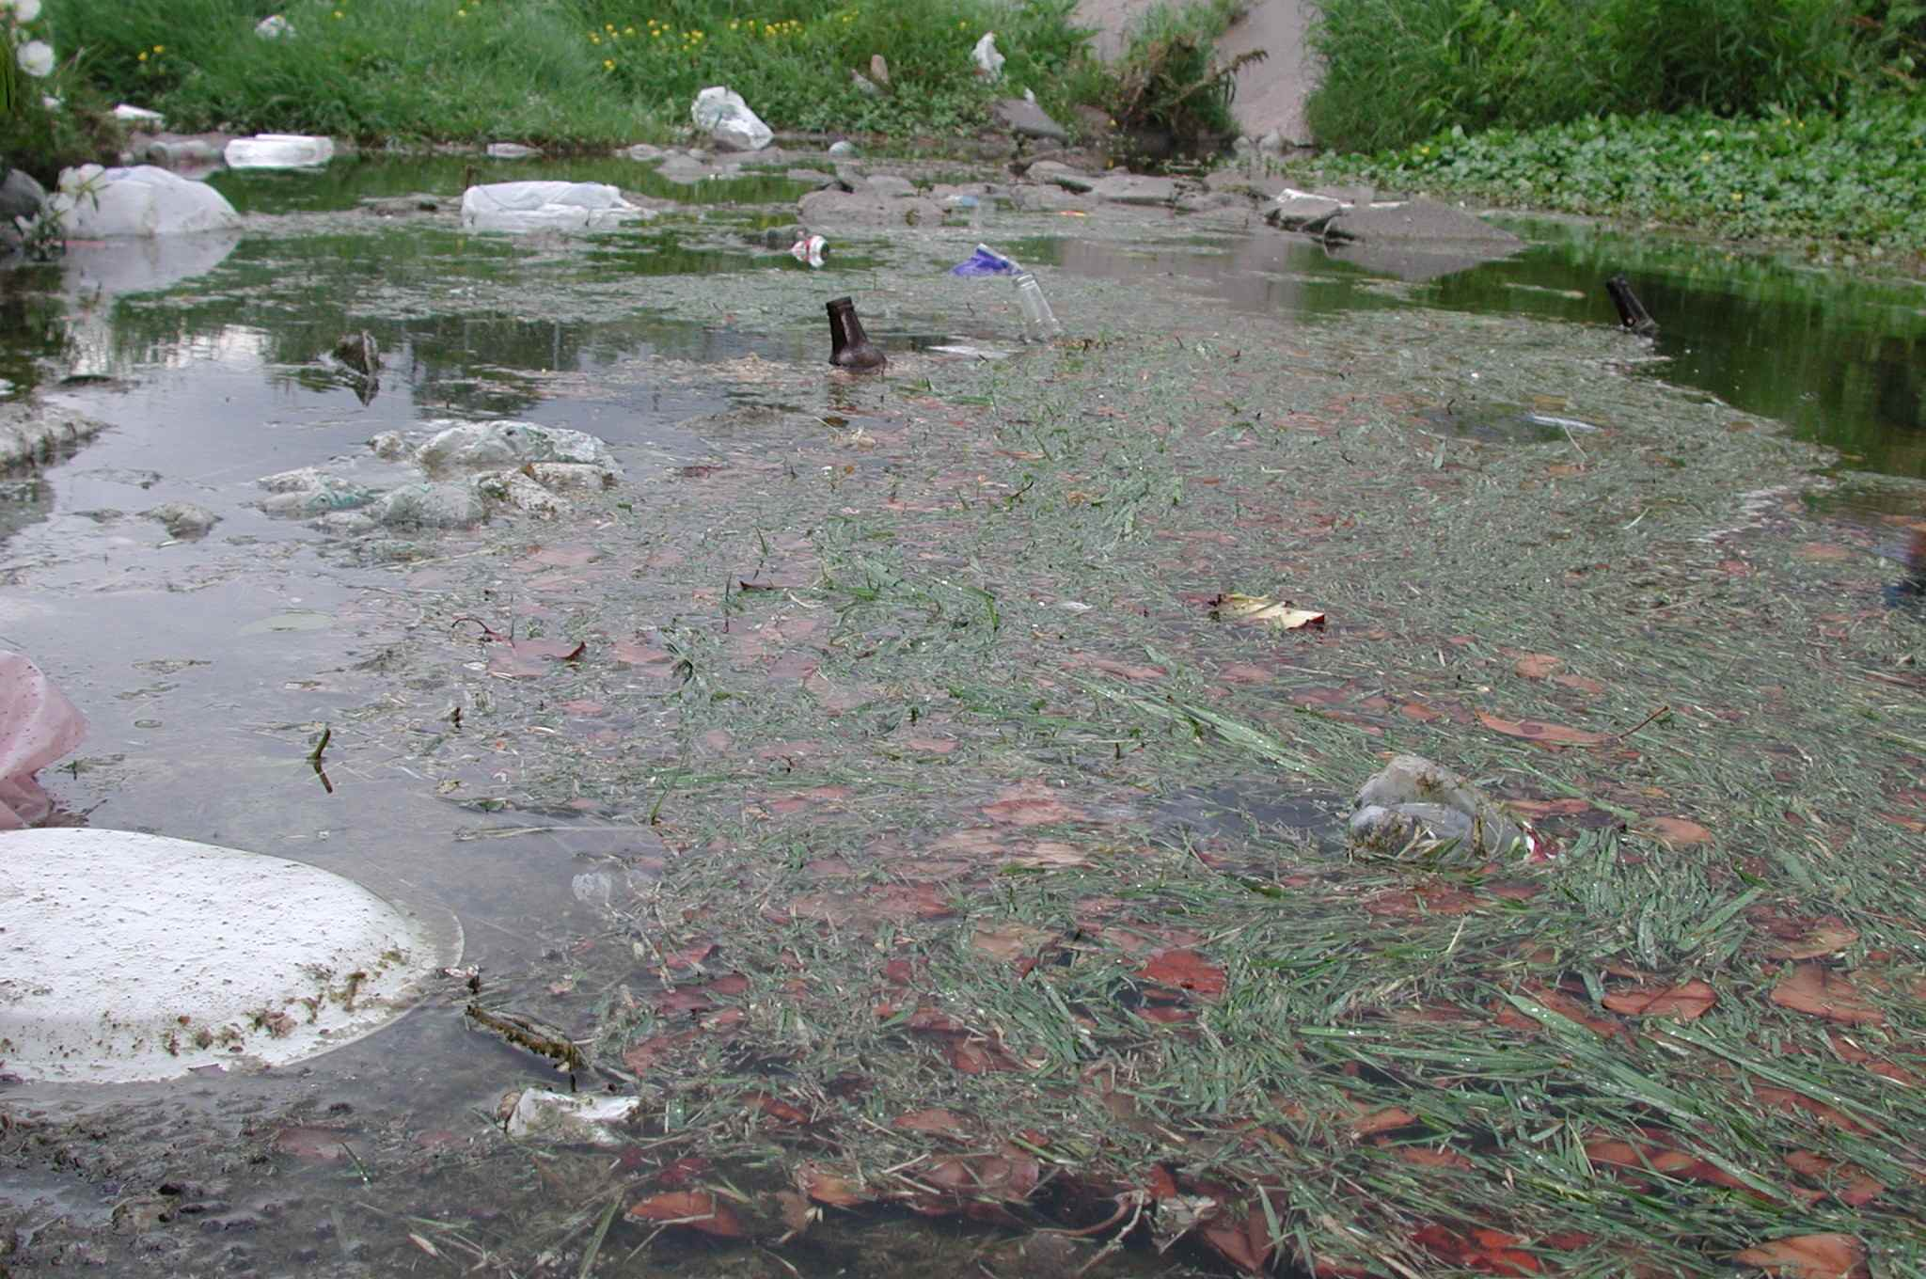
Why is Stormwater Runoff Important?
Stormwater runoff can pick up debris, chemicals, dirt, and other pollutants
Stormwater runoff is NOT treated before it is discharged into local streams, creeks, rivers, and lakes
Lakeland, FL

Slide 5
What is an Illicit Discharge?
Any discharge to the storm sewer system that is not composed entirely of stormwater
Exceptions include:
Water line flushing
Runoff or return flow from landscape irrigation
Discharges from potable water sources
Diverted stream flows
Rising ground waters and springs
Uncontaminated ground water infiltration
Uncontaminated pumped ground water
Foundation and footing drains
Air conditioning condensation
Water from crawl space pumps
Individual residential vehicle washing
Flows from wetlands and riparian habitats
Dechlorinated swimming pool discharges
Street wash water
Discharges or flows from fire fighting activities
Etc.

Slide 6
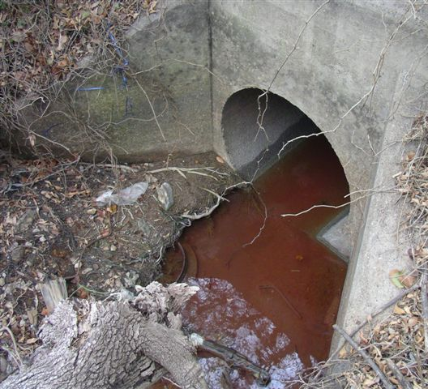
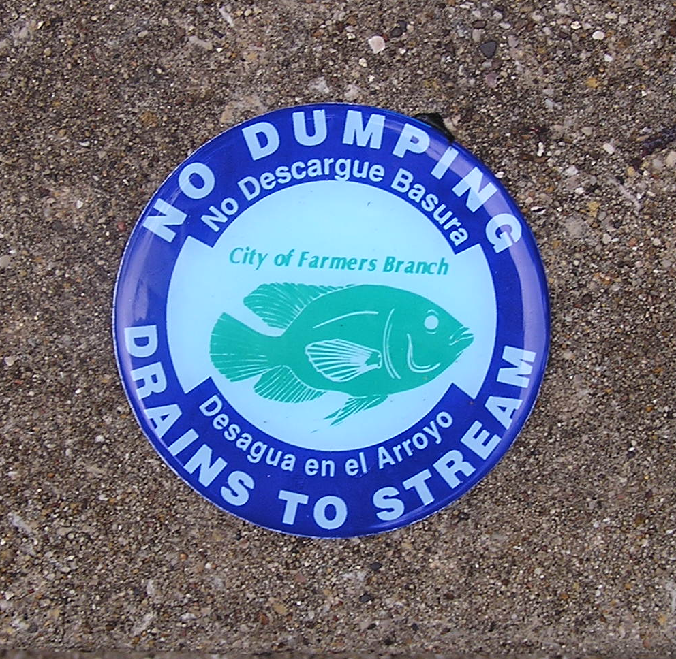
Why are Illicit Discharges Important?
Illicit discharges often include pathogens, nutrients, toxic pollutants, etc.
Illicit discharges = pollution
Anything that enters a storm sewer system flows untreated to a local waterway
Irving

Slide 7


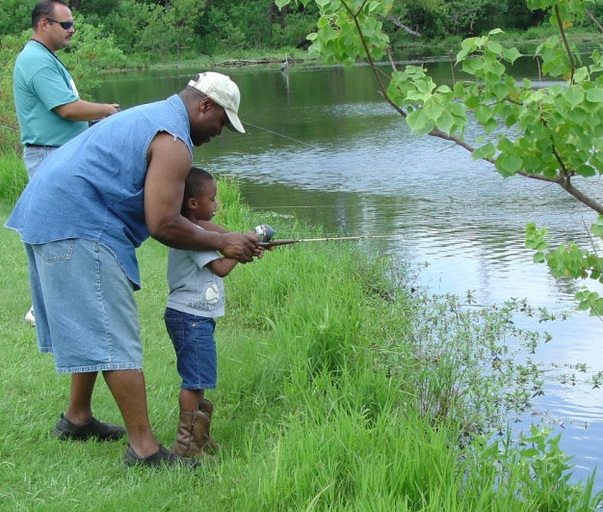
Why Should You Care?
We use local waterways for swimming, fishing, boating, and as a source of drinking water
The Borough of Exeter is required to prevent pollutants from entering the storm sewer system
Wayne County, MI

Slide 8
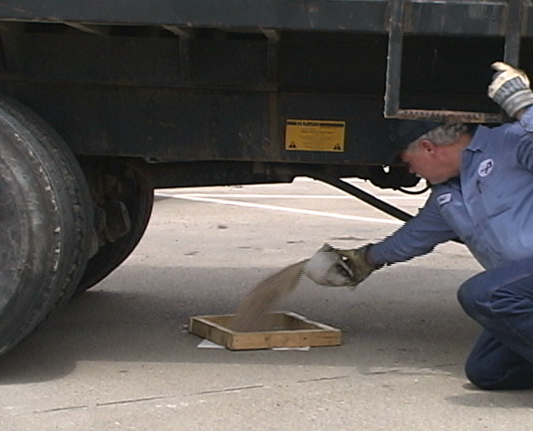
What Can You Do?
Employees can help prevent stormwater pollution by:
Preventing pollutants from being dumped or spilled into the storm sewer system (this includes driveways, sidewalks, streets, storm drains)
Reporting pollution or questionable discharges to the storm sewer system or local waterways

Slide 9
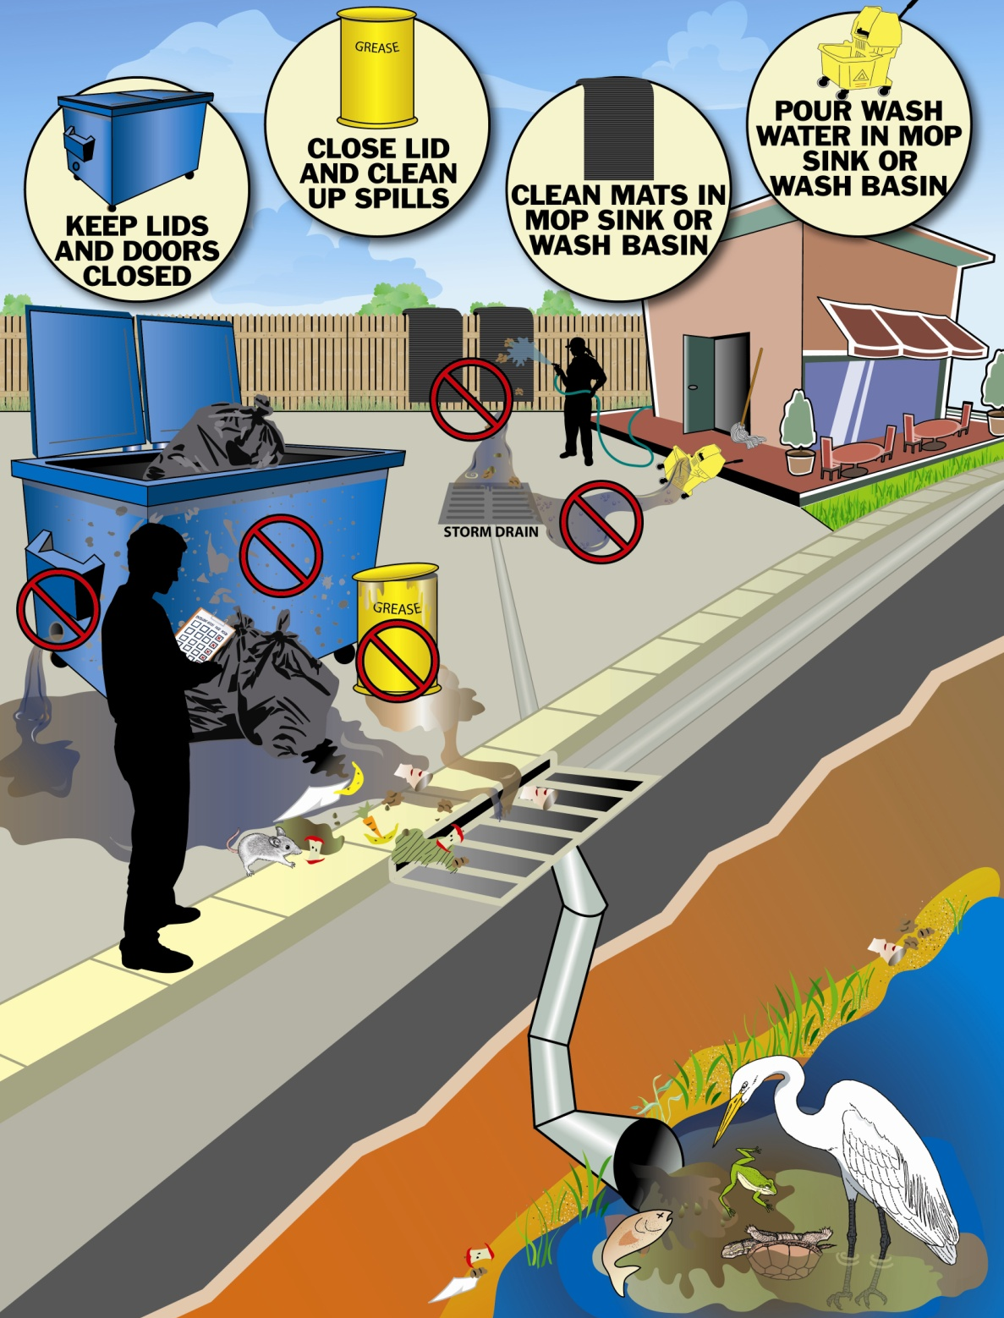
Preventing Pollution
Store and handle materials safely
Clean up spills properly
Never dump or wash out items down or near a storm drain
Courtesy NCDENR
Courtesy NCDENR

Slide 10
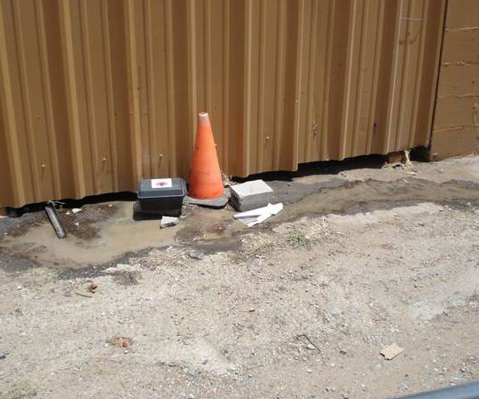

Reporting Pollution
If you see questionable discharges entering the storm sewer system or someone dumping something down the storm drain, report it
Grand Prairie
Montgomery County, MD

Slide 11
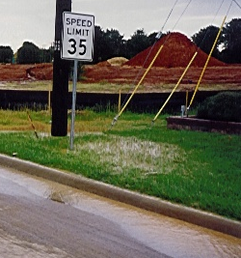
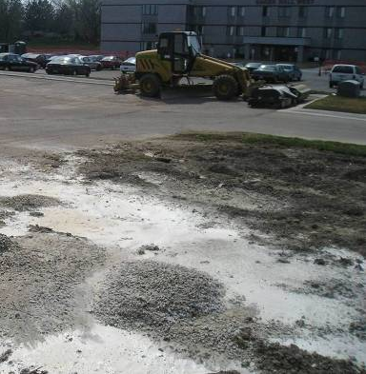
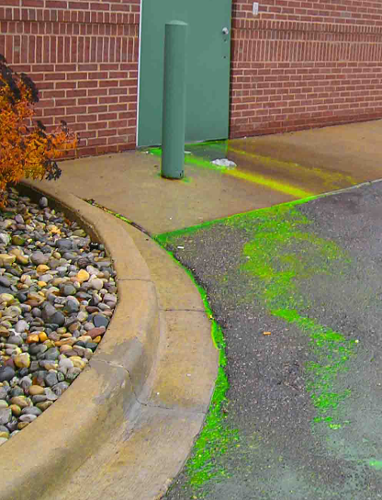
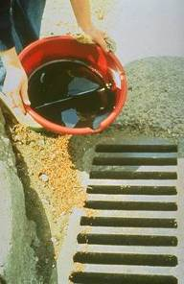
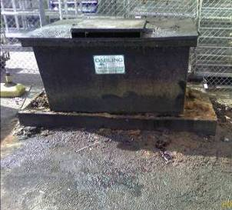
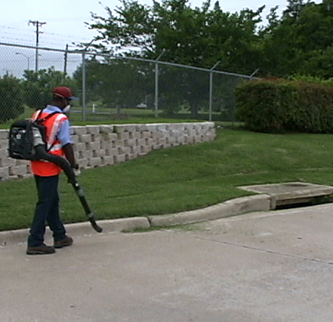
Examples of What to Report Pollution Entering the Storm Sewer System
Arlington
Tetra Tech
Tetra Tech
Tetra Tech
Unusually colored discharges
Dirty water in the street
Wash out of solids/liquids
Liquids dumped down a storm drain
Leaks
Solids blown or swept in the street or down a storm drain
Tetra Tech

Slide 12
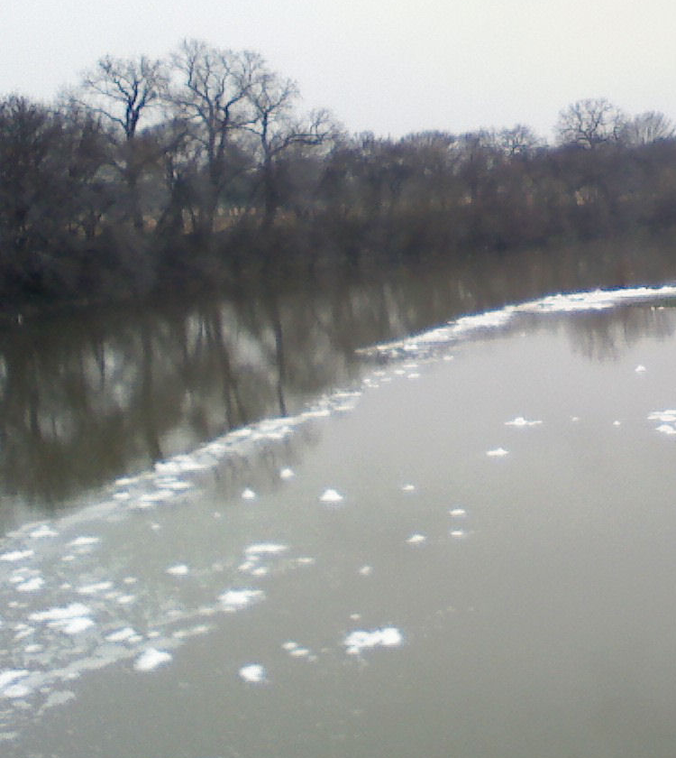
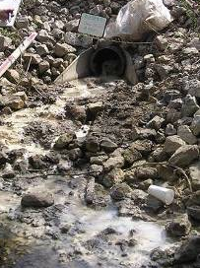
Reporting Pollution
If you see warning signs of pollution coming out of a pipe or in a local waterway, report it
Warning signs may include the presence of unusual:
Color
Odor
Turbidity
Floatable liquids and solids
Etc.
Fort Worth
Tetra Tech

Slide 13
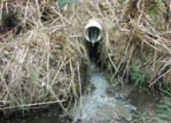
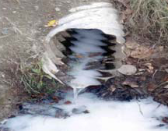
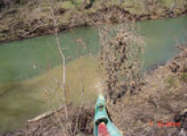
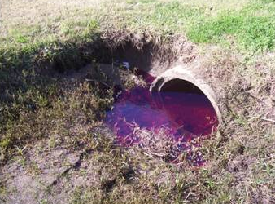
Examples of What to Report Unusual Water Color
Milky gray-black
Pea-green/
bright green
Milky white
Center for Watershed Protection
Fort Worth
Dark red, purple, blue, black
Dr. Robert Pitt
Tan to light brown
Don Green, Franklin, TN
Grand Prairie
Notes:
Pea-green/bright green picture: Algae
Milky white picture: Paint washwater
Milky gray-black picture: Failing septic system
Tan to light brown picture: Discharge from a construction site
Purple dye picture: Red-dyed diesel spill

Slide 14
Examples of What to Report Unusual Odor
Some odors are an immediate indicator of pollution
Sewage, gasoline, and chemical odors should be reported
Odor | Causes
Rotten eggs/hydrogen sulfide | Raw sewage, decomposing organic matter, lack of oxygen
Sharp, pungent odor | Chemicals or pesticides
Gasoline, petroleum | Industrial discharge, illegal dumping of wastes, waste water

Slide 15
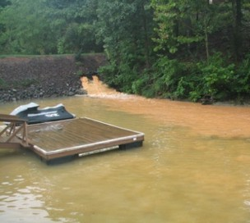
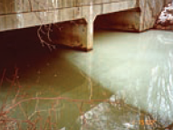
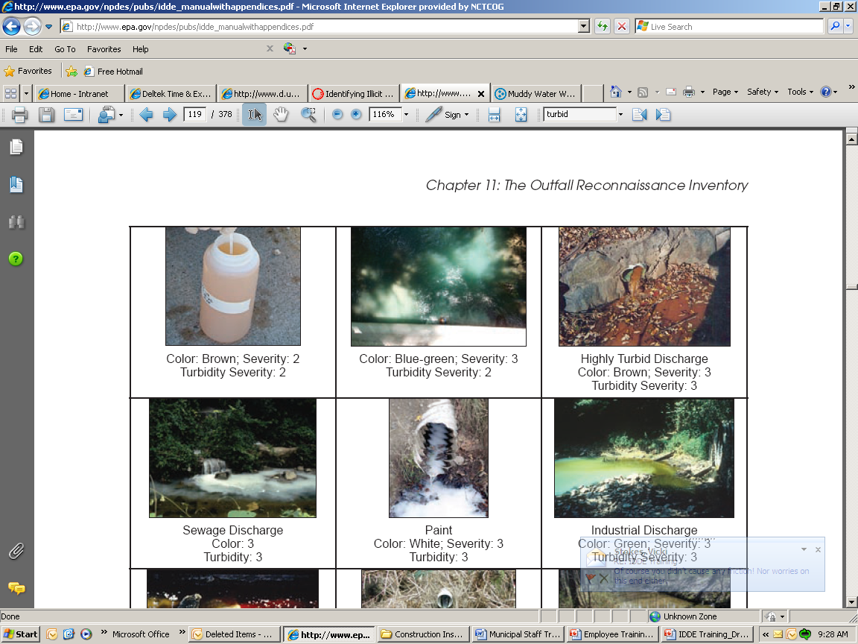
Examples of What to Report Highly Turbid Water
Construction site discharge
Discharge of rinse from floor sanding
Rachel Calabro, MA Dept of Env Protection
Catawaba Riverkeeper
Unknown brown turbid discharge
Sewage discharge
Rachel Calabro, MA Dept of Env Protection
Center for Watershed Protection

Slide 16
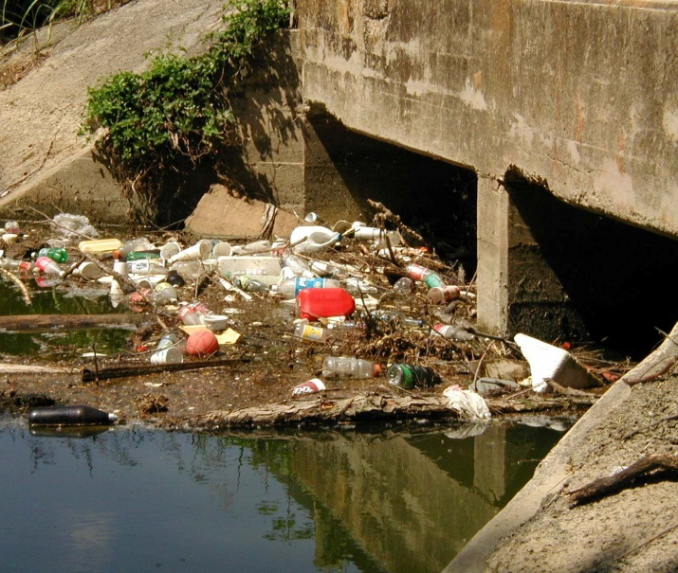
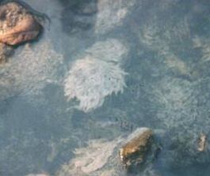
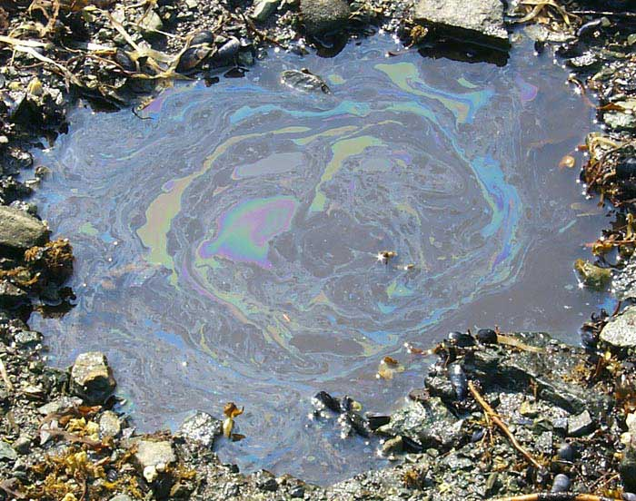
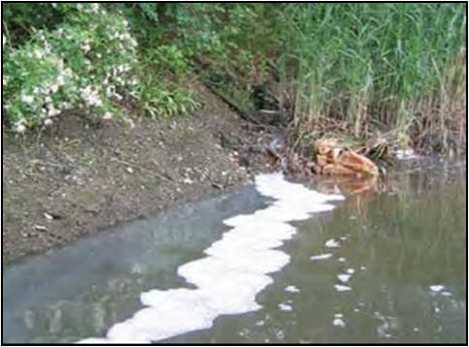
Examples of What to Report Floatables in the Water
Trash and debris
Leaves and grass clippings
Sewage fungus
Oil sheen
Suds
Wayne County, MI
Jane Thomas, IAN Image Library
Center for Watershed Protection

Slide 17
How to Report
Inform the Borough
Include the following information:
Specific location
Date and time
Description of the pollution
Description of the violator, e.g. license plate #, personal description (if applicable)
Your contact information
Email a picture if you can

